Slide 1
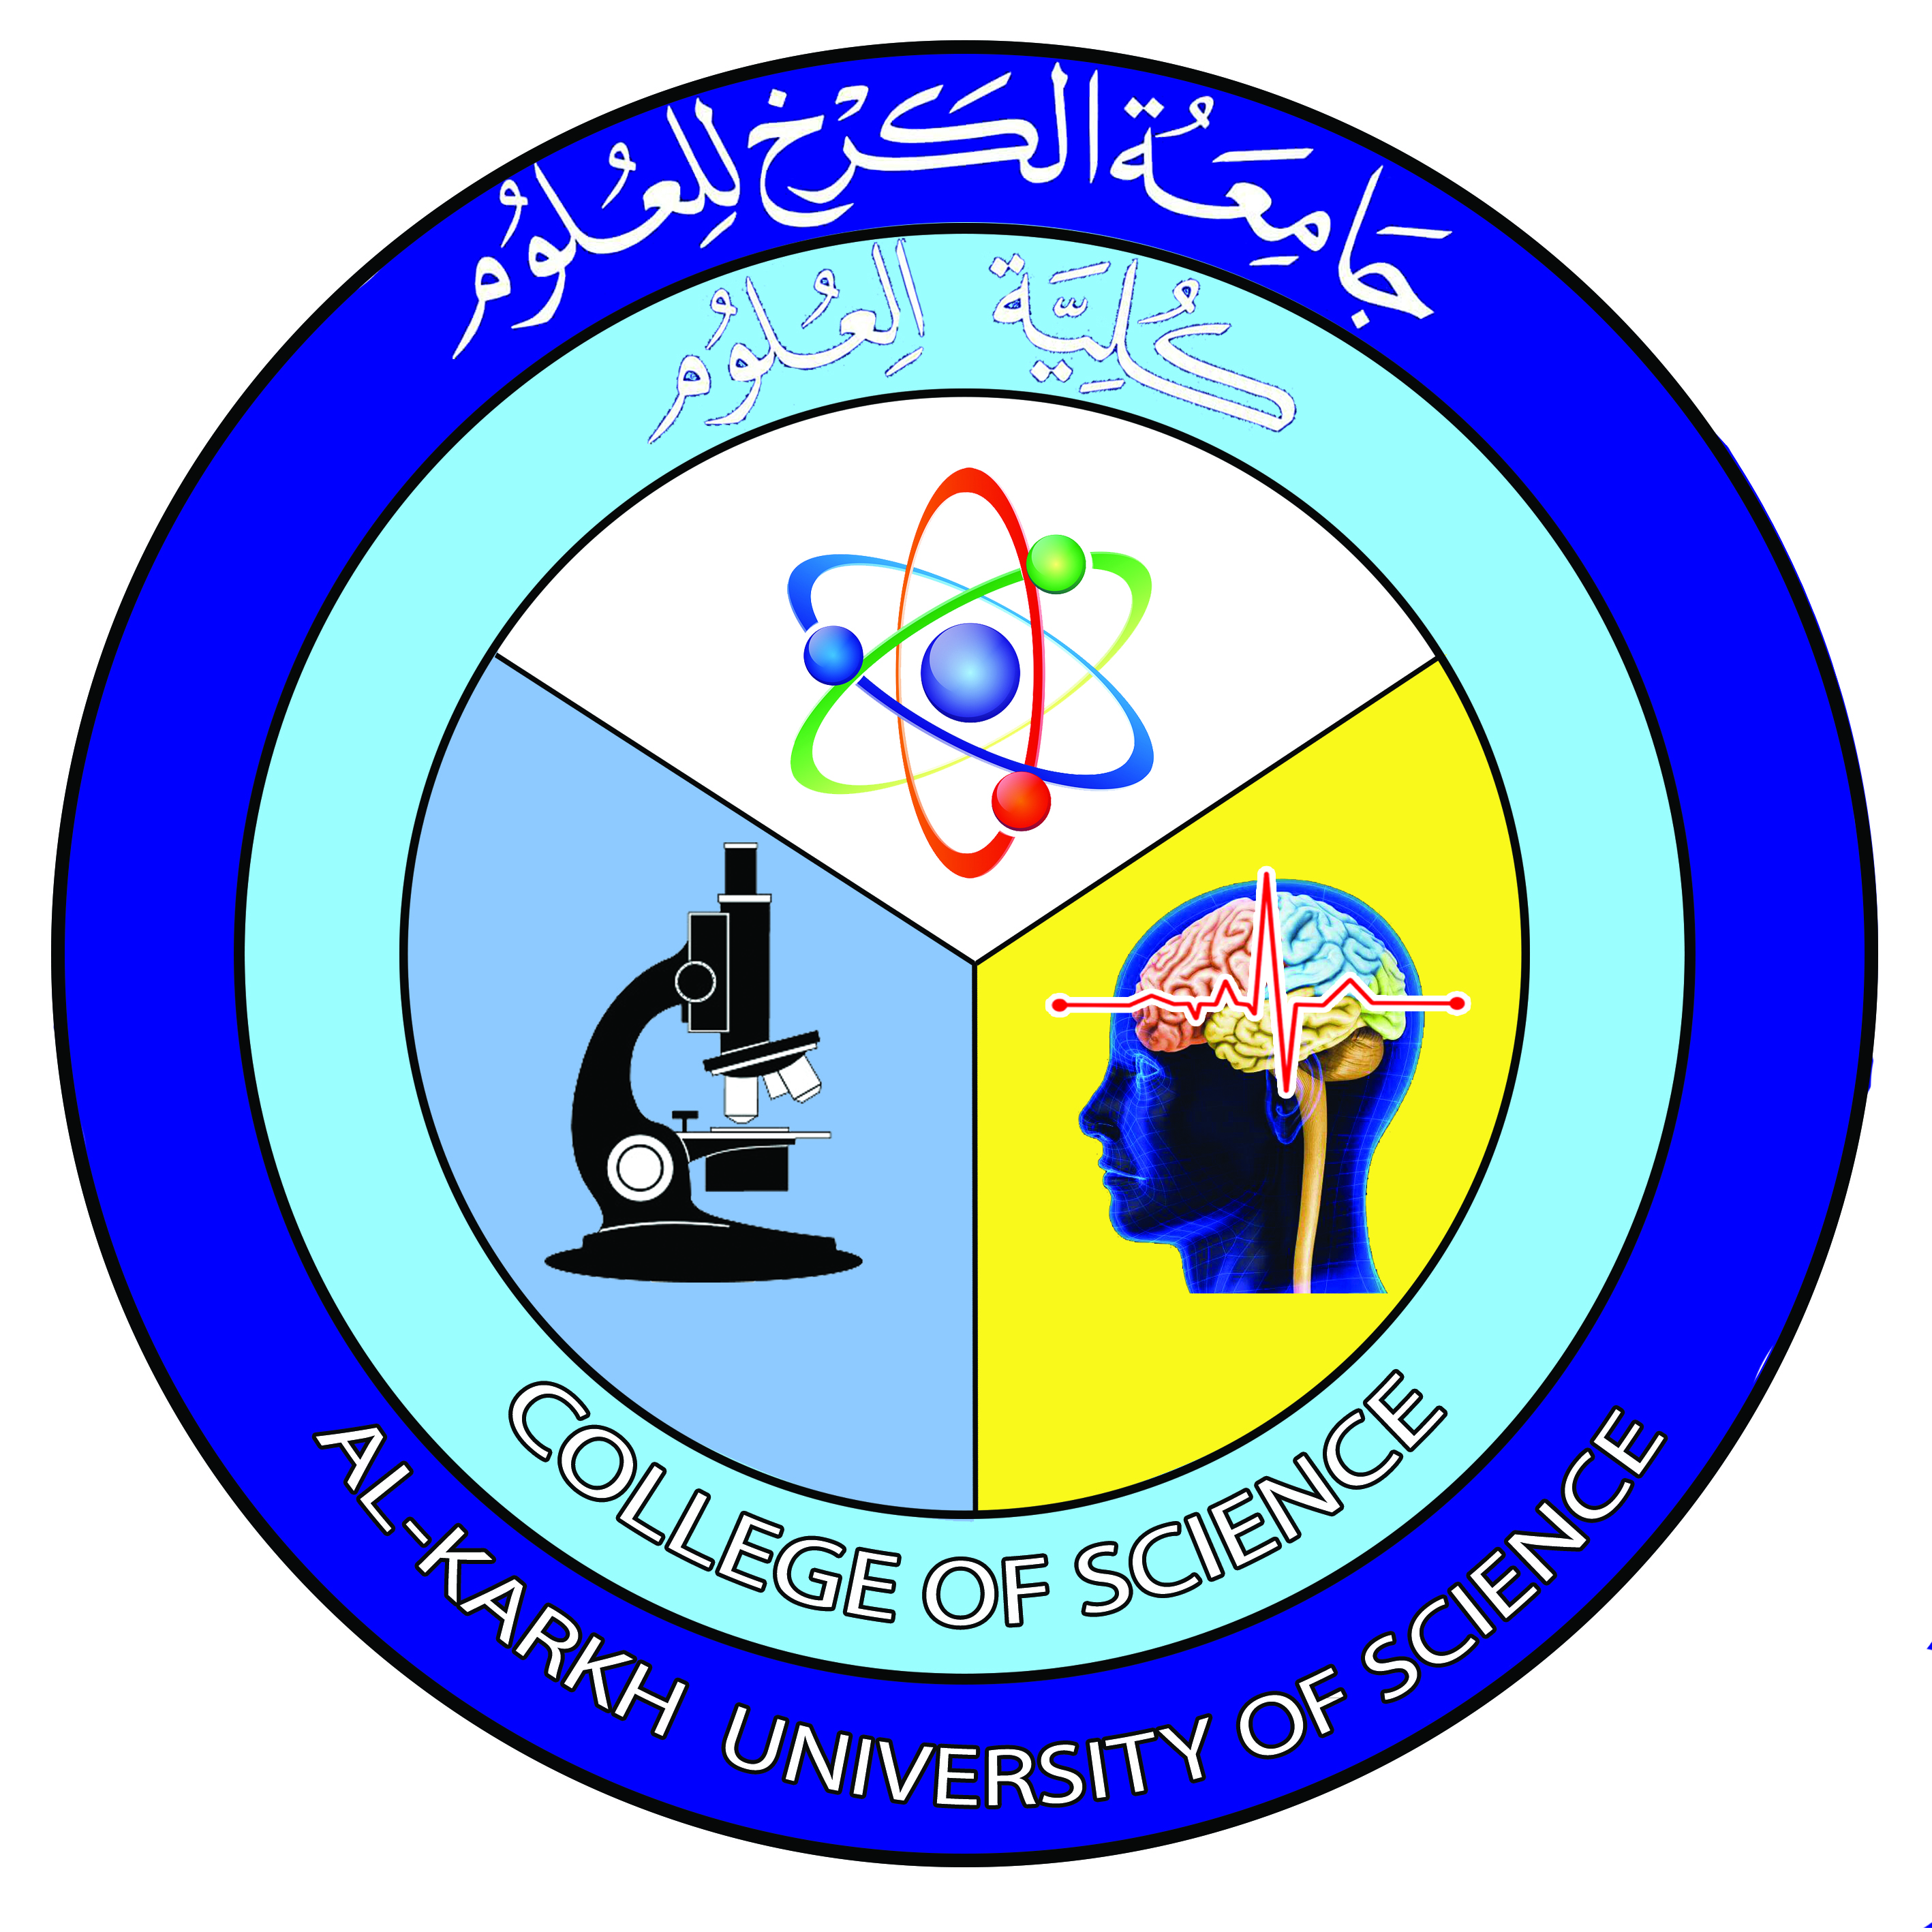

Introduction to Molecular Biology
Lecture 1
Dr. Rawa Abdul Redha Aziz
Ph.D Antibiotics/ Molecular biology

Slide 2
Syllabus Content
Subject | Lec. No.
Introduction and Brief historical review | 1
Experiments to prove DNA is the genetic material | 2
The second evidence using virus (phage) model | 3
DNA and RNA as macromolecules: basic structure and roles | 4
Eukaryotic and prokaryotic DNA | 5
Chemical and physical properties of DNA: The hyperchromic effect | 6
Haploid chromosome | 7
Chromatin organization and chromosome structure | 8
DNA replication | 9
DNA repair pathways | 10
RNA structure and function | 11
RNA transcription and post transcription events | 12
Translation: protein synthesis | 13
Epigenetics | 14
Final Exam | 15

Slide 3
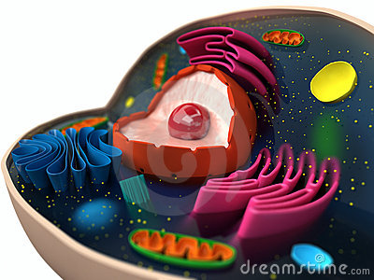
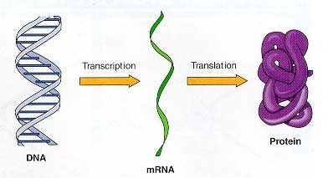
Introduction and Brief historical review
Identification of molecular biology:
It is the science that deals with macromoleculaes. The aims of molecular biology are to understand the five basic behaviors pattern (growth, division, speacialization, movements and interaction) in terms of the fine molecules responsible for them including (DNA, RNA, and Protein).

Slide 4
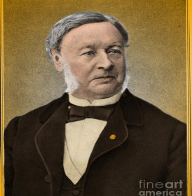

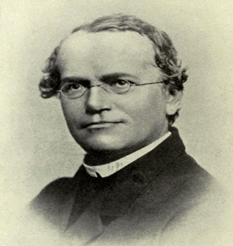
The Early Years:
The German physiologiest Theodor Schwan (1839) who discovered the Schwann cells in the peripherial nervous system
The German scientist Gregor Mendel (1865) demonstrated that the inheritance of certain traits in pea plants follows particular patterns, now referred to as the laws of Mendelian inheritance.

Slide 5
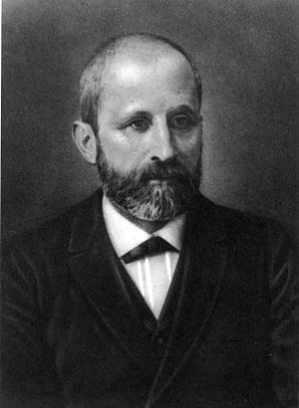
Freidrich Miescher (1869) was a Swiss physician and biologist. He was the first researcher who isolates and identifies nucleic acid. It was a phosphate-rich chemicals, which he called nuclien, from nuclei of WBC without knowing responsibility of inheritance. So, he knew much of the chemical structure of nucleic acid molecule but the function of it was known a century later. However, his discovery played an important part in the identification of nucleic acids as a carrier of inheritance

Slide 6
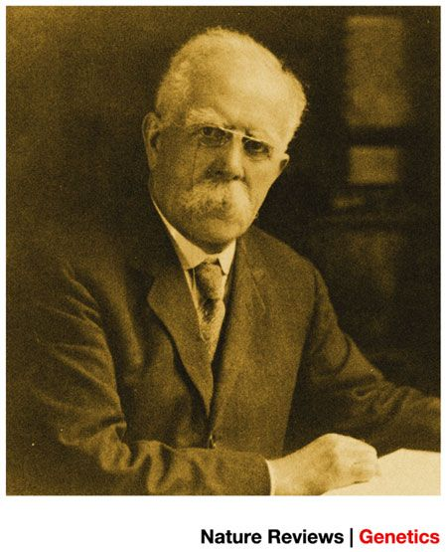
Sir Archibald Garrod an English physician who pointed the field of inborn errors of metabolism in (1904). He also discovered alkaptonnuria which is a human disease charachterize by black urine due to accumulation of unusual metabolic products, understanding its inheritance. The disease was studied latter by two American scientists Beadle and tatum (1930-1940).

Slide 7
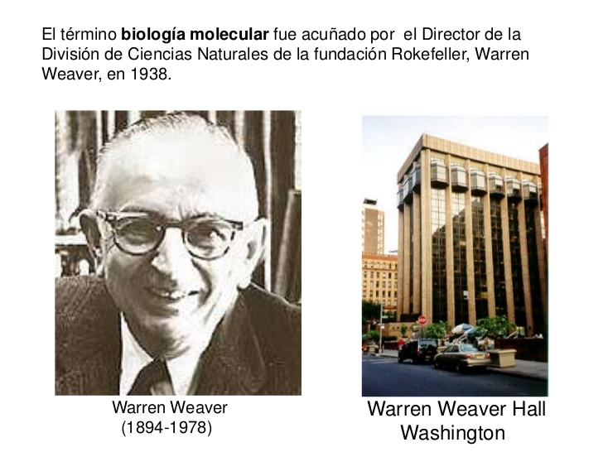
Warren Weaver (1938) was the first biologist used the term molecule biology as a new branch of science at that time the biochemists began to discover many fundamental chemical reactions and numerous properites of the cell.

Slide 8
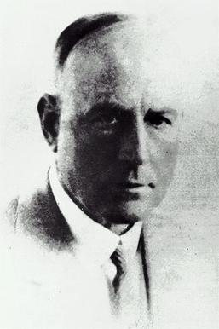
Griffith’s Experiment to identify the genetic material (Bacterial model)
Griffith’s experiment, reported in (1928-1929) by Frederick Griffith (British scientist), was one of the first experiments suggesting that bacteria are capable of transferring genetic information through a process known as transformation but he did not realized the nature of the genetic materials.

Slide 9
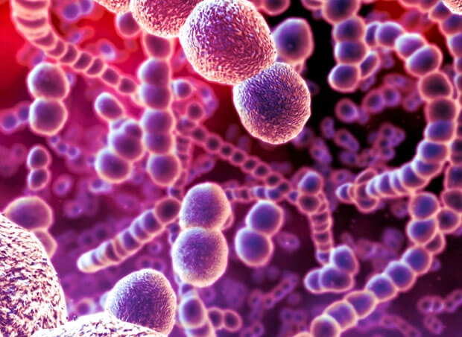
Griffith used two strains of pneumococcus (Streptococcus pneumonia) which is G+ bacteria infect mice – a type III-S (smooth) and type II-R (rough) strain. The III-S strain covers itself with a polysaccharide capsule that protects it from the host’s immune system, resulting in the death of the host, while the II-R strain doesn’t have that protective capsule and is defeated by the host’s immune system.

Slide 10
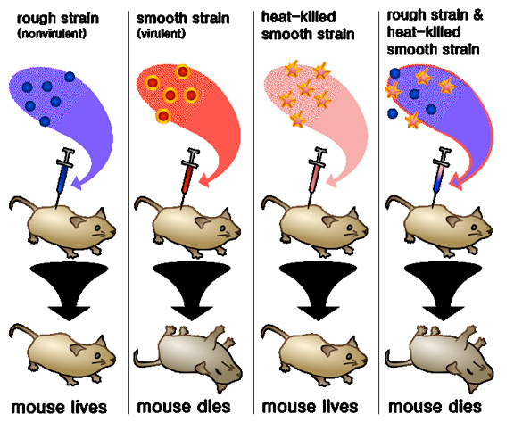

Slide 11
Avery-Macleod-Mccarty Experiment
The Avery- Macleod-McCarty experiment was reported in 1944, by Oswald Avery, Colin Macleod, and Maclyn McCarty, that DNA is the substance that causes bacterial transformation. It was started in 1930s and early 1940s to purify and characterize the “transforming principle” which was first described by Griffith’s experiment of 1928: start with
1. Heat killing Streptococcus pneumoniae (virulent strain type III-S)
2. Incubation along with living but non-virulent type II-R pneumococci
3. Resulted in production of smooth colonies on media and a deadly infection of type III-S pneumococci (they repeated Griffith experiments).

Slide 12
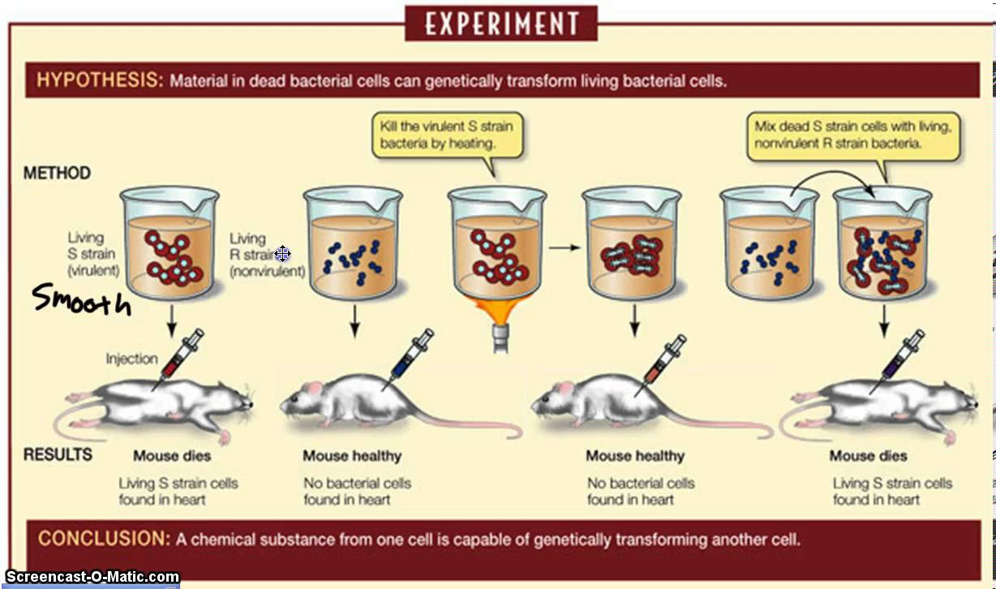

Slide 13

The Transforming Principle in Avery Experiment
Avery and his colleagues start to prove DNA is the genetic material responsible for heredity by transformation process: the principle depends on treating filtrate of S strain with protease and ribonuclease and the process succeed, but is inactivated by treatment with a deoxyribonuclease.
They prove this fact by distraction cells of virulence s strain to realse the genetic material outside the cell then they took the extract and subjected to centrifuge to get read from all intact cells.

Slide 14
They incubated the extract with R strain in cooled condition (4℃) with the addition of CaCl2 then transfer to 42 ℃ (heat shock).
The results showed that the R strain convert to S strain after culturing on agar media.
They repeat the experiment by using only the
DNA they notice the R S.
In the second experiment, they used polysaccharide instead of DNA the result was different because the R didn’t transform to S.

Slide 15
Final Conclusion (1944)
The chemical analysis for the transformed cell contains nucleic acid rather than portion or polysaccarid.
The physical analysis revealed that the nucleic acid was highly vicious rich with phosphoric acid.
Incubation the extract with trypsin (protease) or RNase did not stop transformation process.
Only DNase cause complete inhibition to the process thus they realize that the genetic material is the DNA rather than RNA or the protein
The final process called Transformation

Slide 16
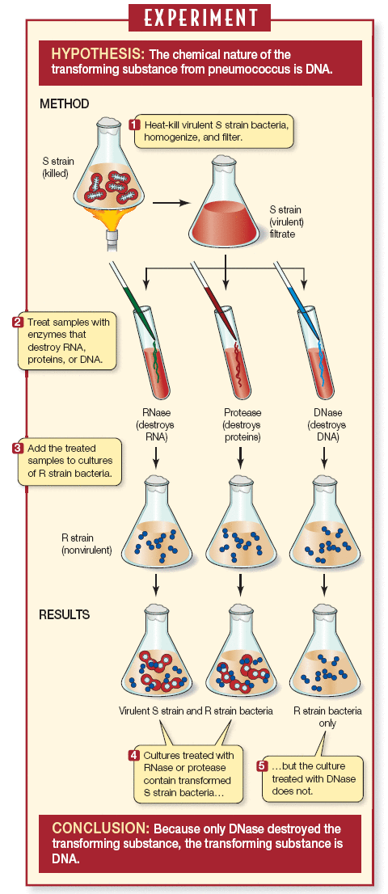

Slide 17

Any Question?

